Slide 1
VendorVision Lender Module Release Features
April 22, 2015
H. Balogh, G. Gabe
Confidential

Slide 2
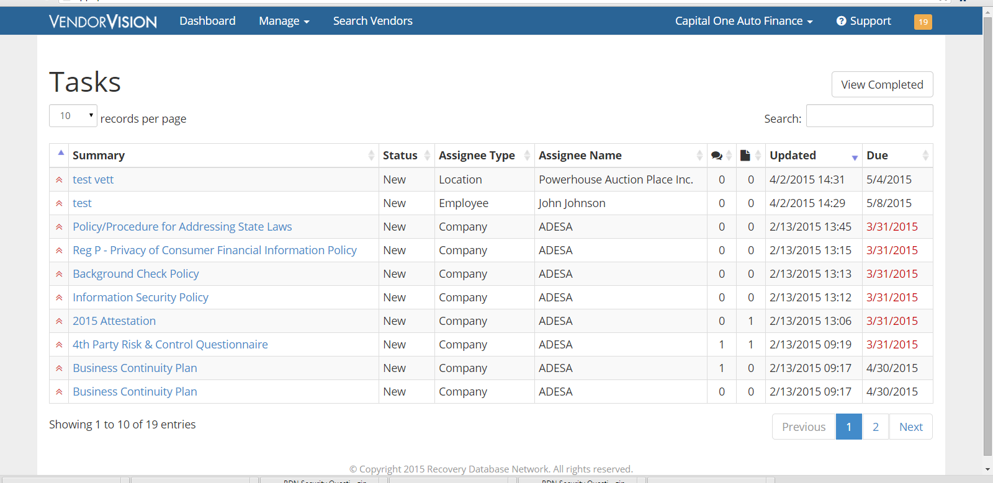
Lenders’ Module Release Features
Task Due Dates: Lenders can easily see when tasks are due!
Notes:
We understand the pain REPO companies go through-
Invested hundred of thousands of dollars in developing what we hope will become the industry standard

Slide 3
Lenders’ Module Release Features
Dashboard Enhancements
Compliance section depicting agent compliance status
Ability to sort Agents by State
Site inspection summary with score
Compliance chart displays agents with incomplete profile
Open tasks displayed

Slide 4
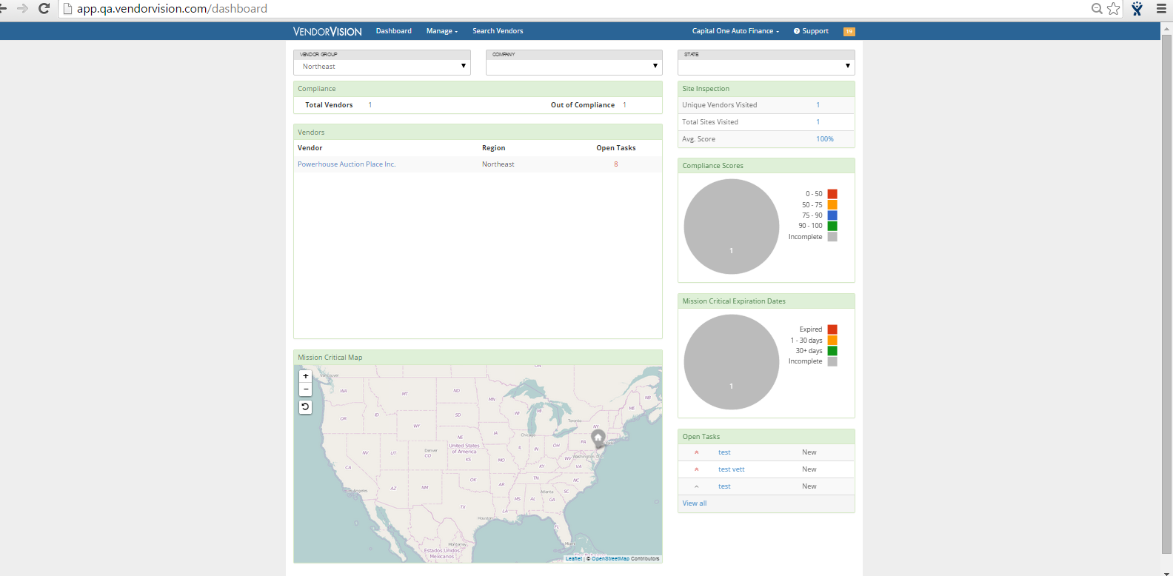
Lenders’ Module Release Features
Group Assignment: Attach a (lender) user to a vendor group so specific group information displays on lender user’s dashboard.

Slide 5
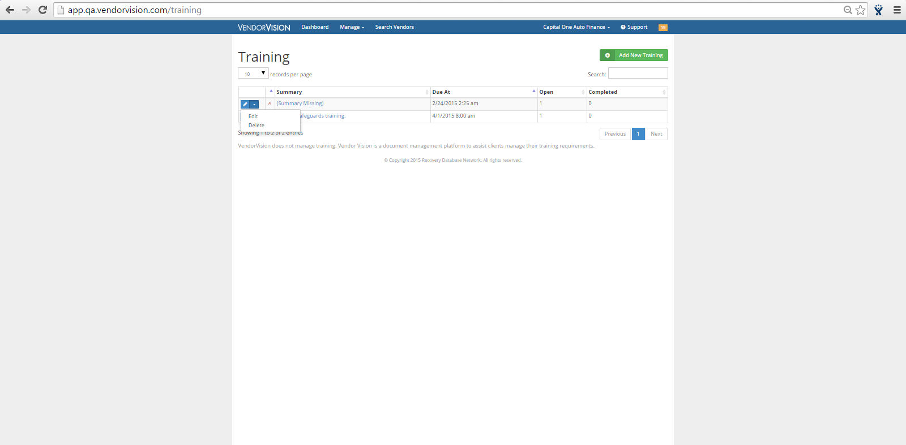
Lenders’ Module Release Features
Additional Lender Edits: Lenders can now edit and delete training assignments!

Slide 6
Support
Please contact Customer Support with any questions or additional information needed regarding these enhancements.
817-204-0298
support@recoverydatabase.net

