Slide 1
VendorVision Agent Module Release Features
April 22, 2015
H. Balogh, G. Gabe
Confidential

Slide 2
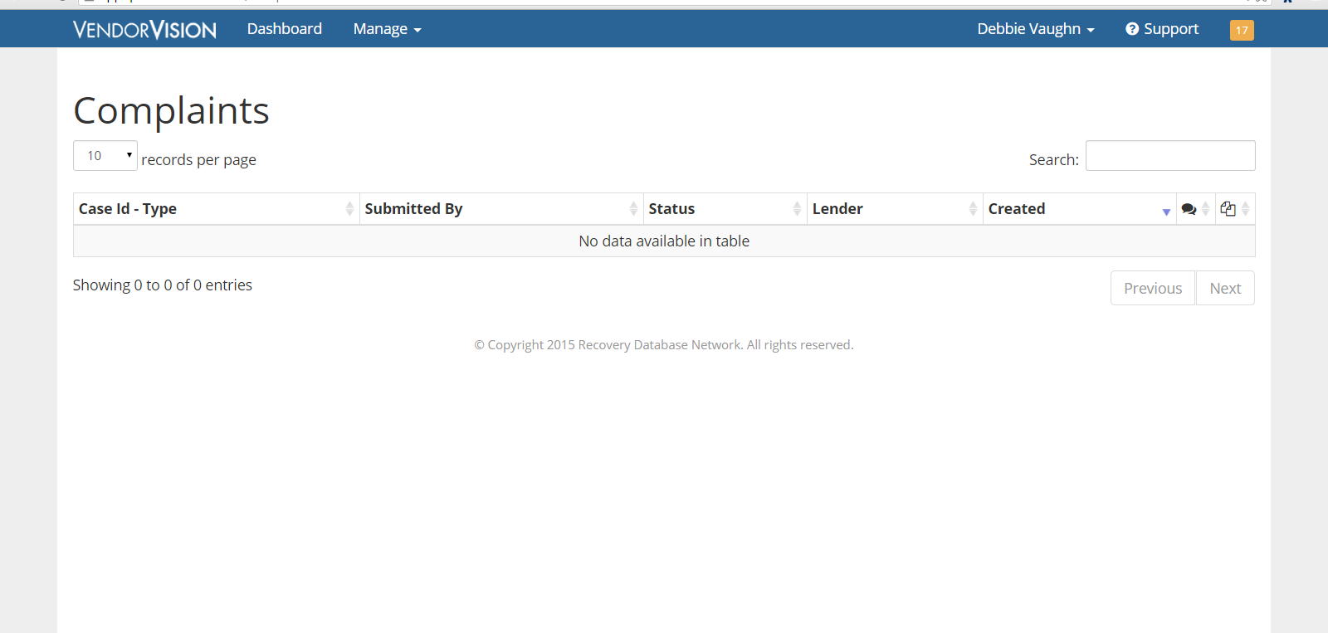
Agents’ Module Release Features
Complaint Overview: Agents will now be able to monitor RDN entered complaint activity in VendorVision!
Notes:
We understand the pain REPO companies go through-
Invested hundred of thousands of dollars in developing what we hope will become the industry standard

Slide 3
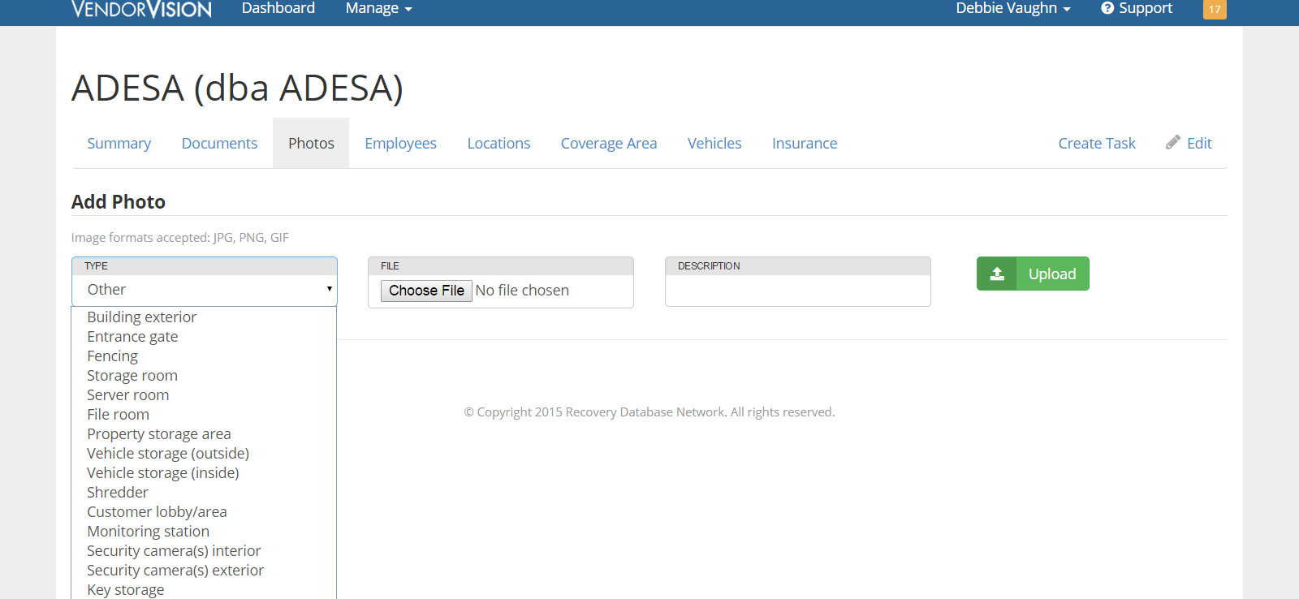
Agents’ Module Release Features
Photo Type: Agents can select the photo type when adding location and company photos.
Notes:
We understand the pain REPO companies go through-
Invested hundred of thousands of dollars in developing what we hope will become the industry standard

Slide 4
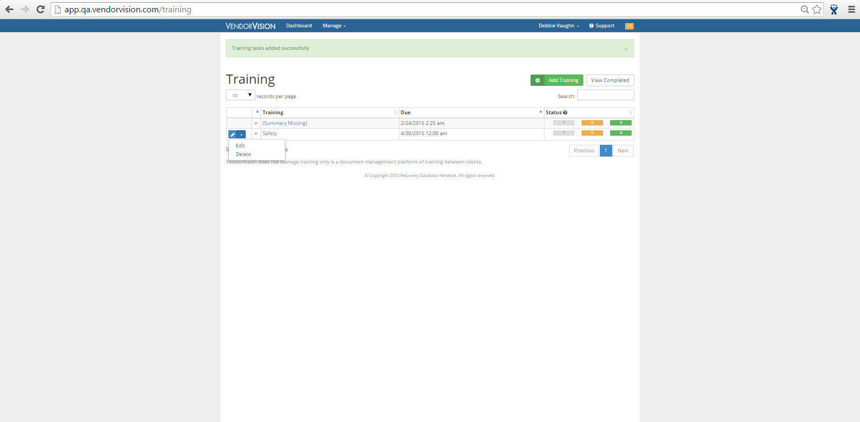
Agents’ Module Release Features
Additional Agent Edits: Agents can now edit and delete training assignments they previously created.
Notes:
We understand the pain REPO companies go through-
Invested hundred of thousands of dollars in developing what we hope will become the industry standard

Slide 5
Support
Please contact Customer Support with any questions or additional information needed regarding these enhancements.
817-204-0298
support@recoverydatabase.net

