Slide 1
VendorVision Agent Module Release Features
January 8, 2015 – March 10, 2015
H. Balogh, G. Gabe
Confidential

Slide 2
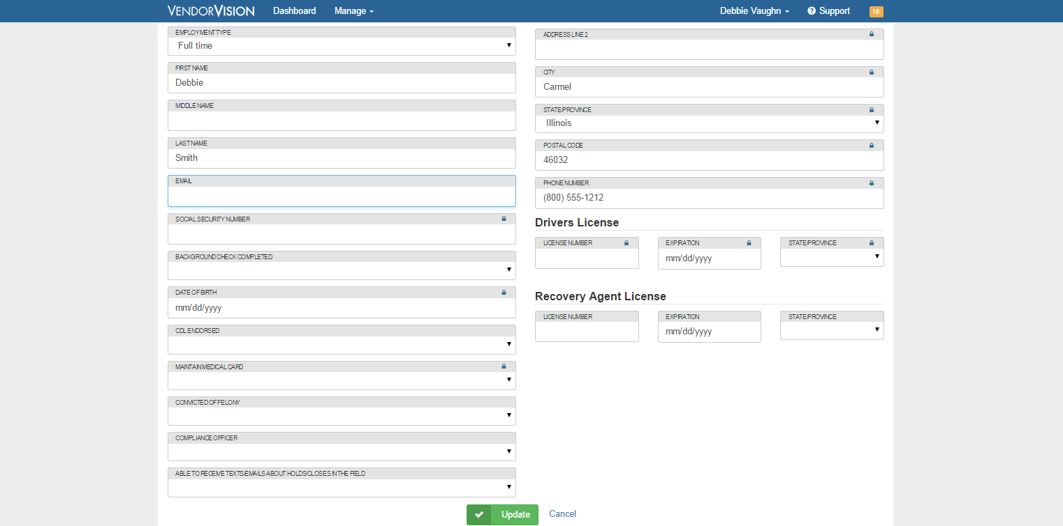
Agents’ Module Release Enhancements
Employee Profile
Email address added

Slide 3
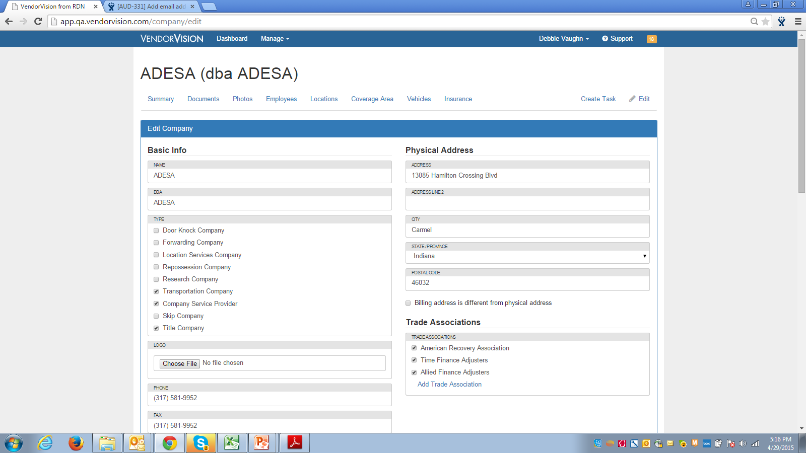
Agents’ Module Release Enhancements
Company Edit
Ability to add Company Logo

Slide 4
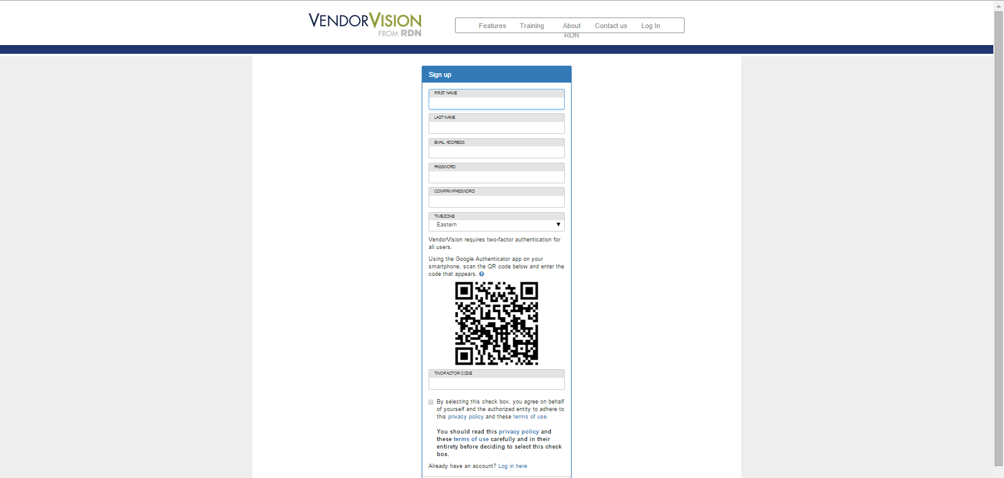
Agents’ Module Release Enhancements
Registration Processing
Added ‘terms and conditions’ agreement when registering for system access
Ability to add Company Logo

Slide 5
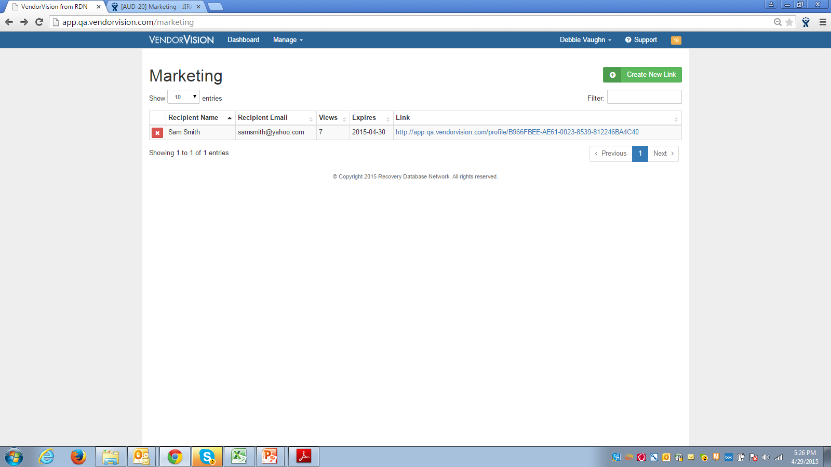
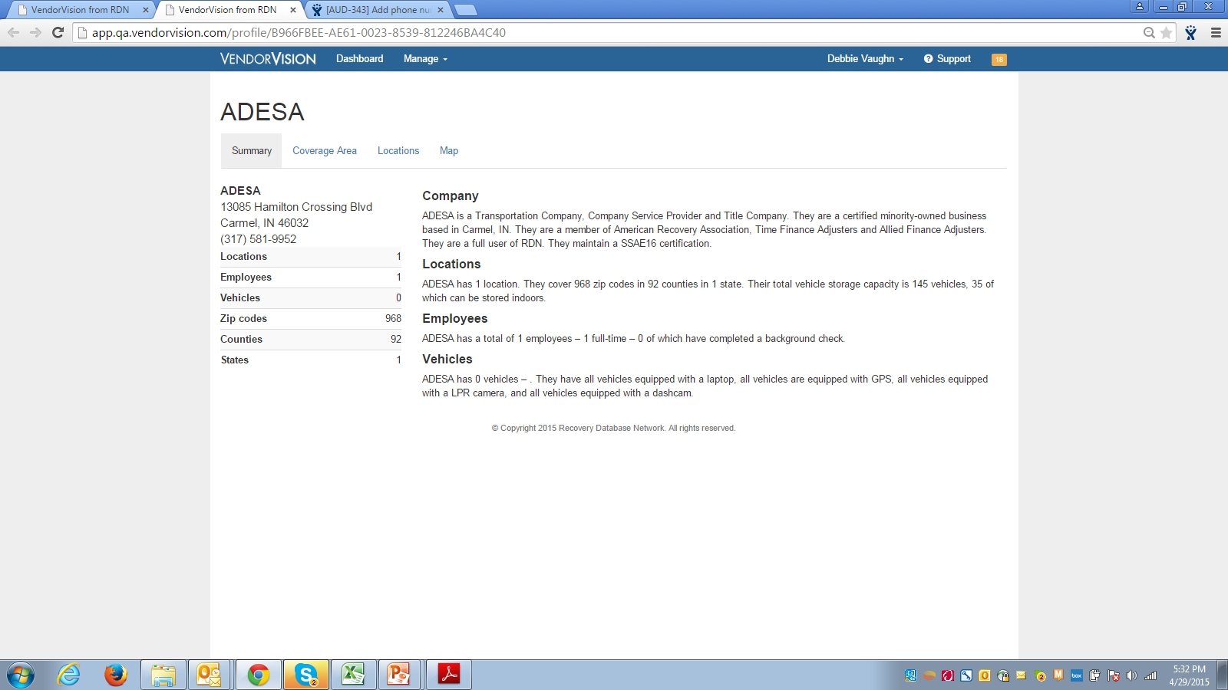
Agents’ Module Release Enhancements
Marketing Enhancements
Agents can share their profile with prospective Clients
Agent’s phone number added

Slide 6
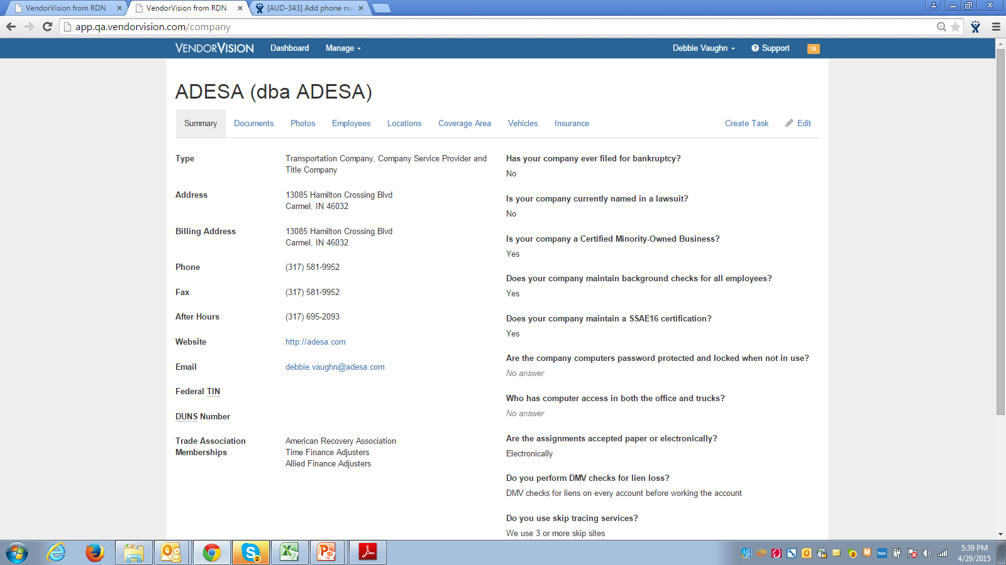
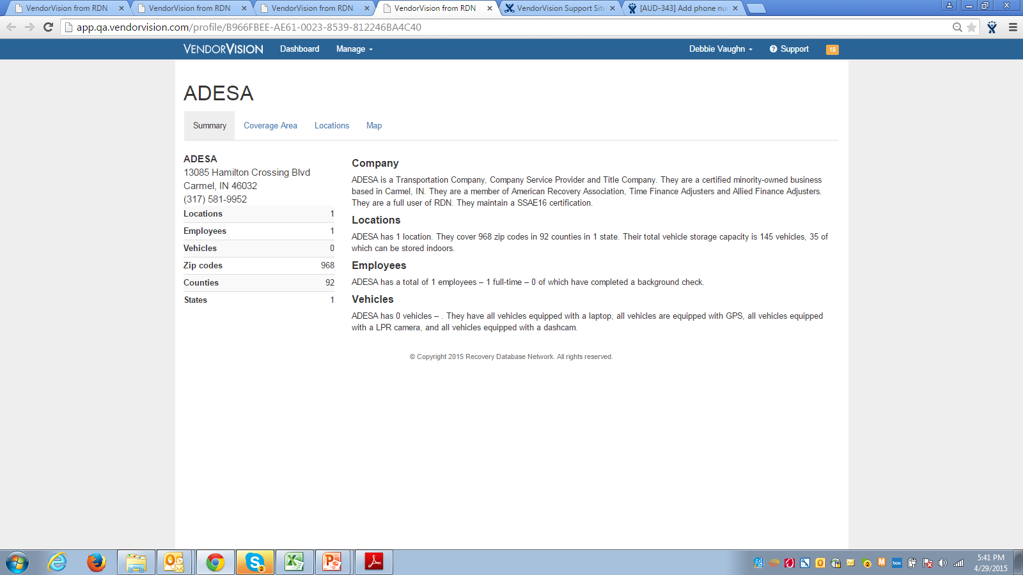
Agents’ Module Release Enhancements
Trade Association
Added trade associations to two locations

Slide 7
Support
Please contact Customer Support with any questions or additional information needed regarding these enhancements.
817-204-0298
support@recoverydatabase.net

