Slide 1
VendorVision Lender Module Release Features
January 8, 2015 – March 10, 2015
H. Balogh, G. Gabe
Confidential

Slide 2
Lenders’ Module Release Features
Employee Profile
Email address added

Slide 3
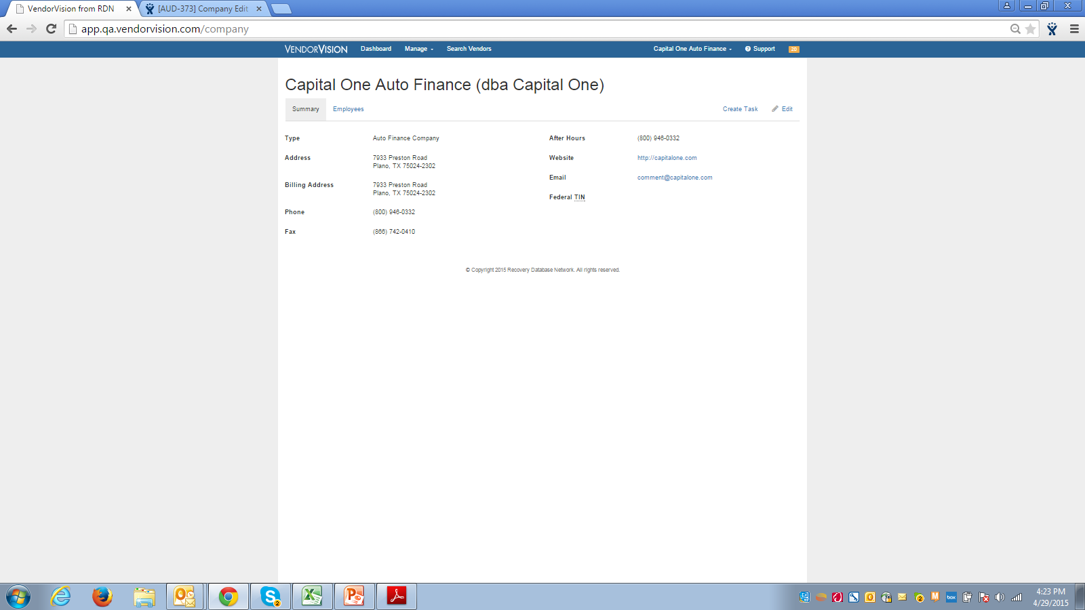
Lenders’ Module Release Features
Company Edit
Edit company option added

Slide 4
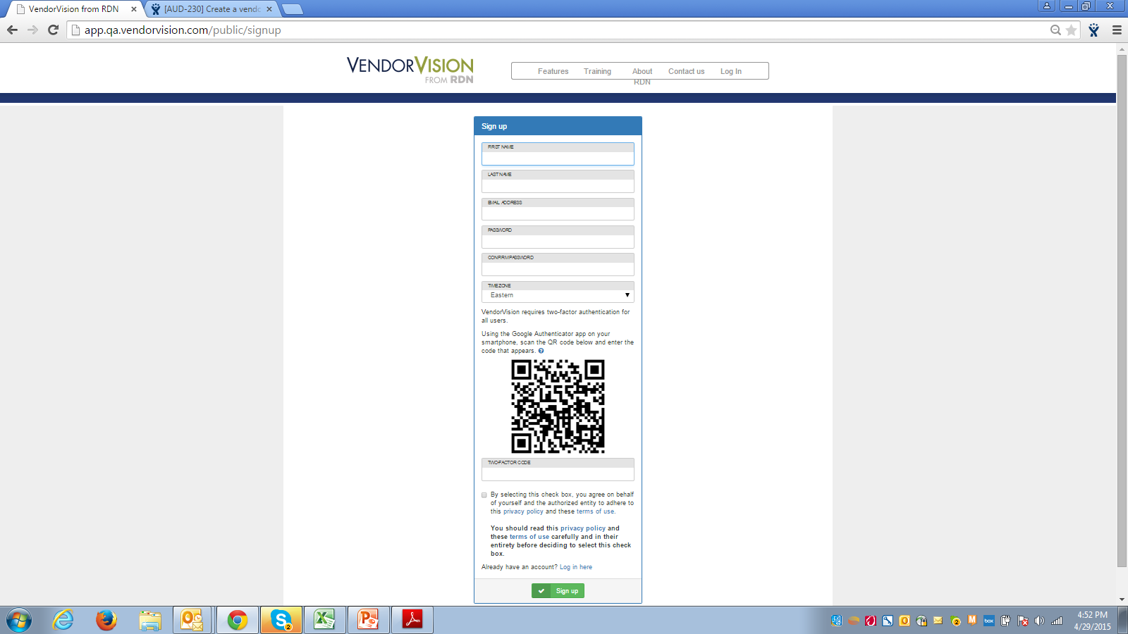
Lenders’ Module Release Features
Registration Process
Added ‘terms and conditions’ agreement when registering for system access

Slide 5
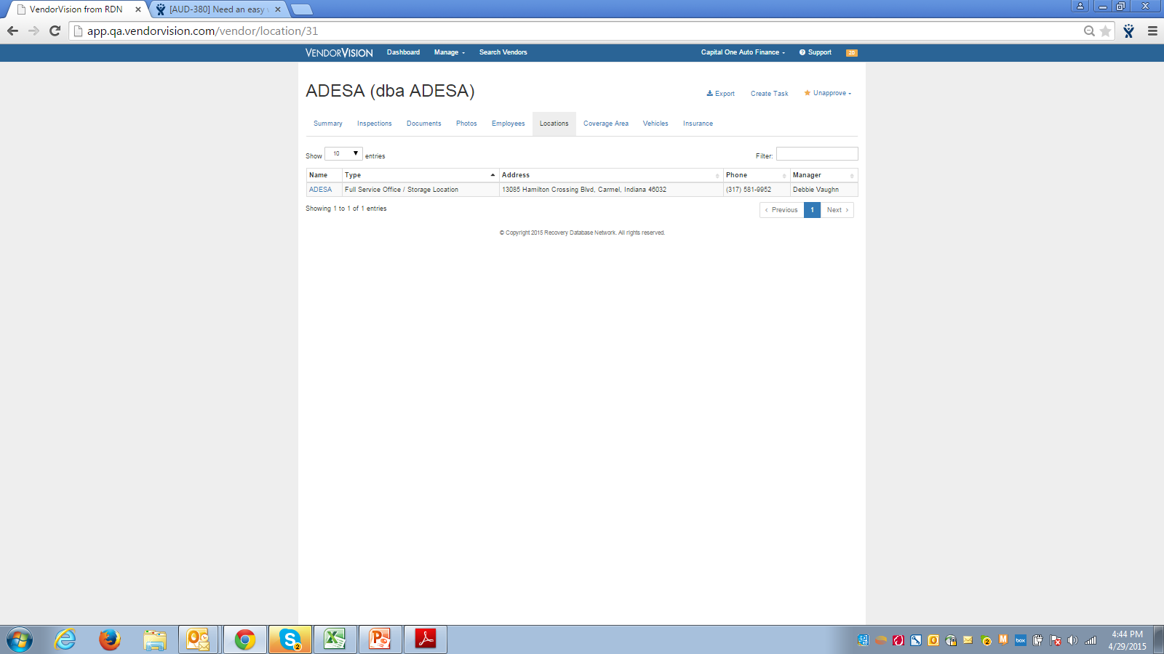
Lenders’ Module Release Features
Navigation Enhancement
Added Company Name and link to Company Profile

Slide 6
Lenders’ Module Release Features
On-site Inspection Enhancements
PDF Export Option Added
Link to associated inspection question
Jump to first unanswered question

Slide 7
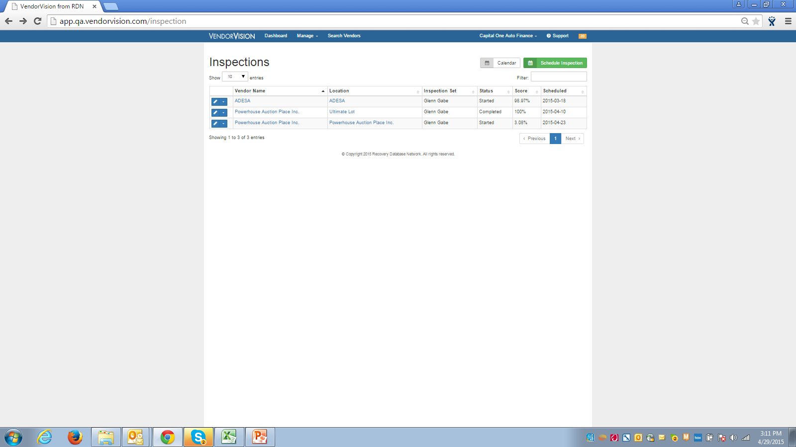
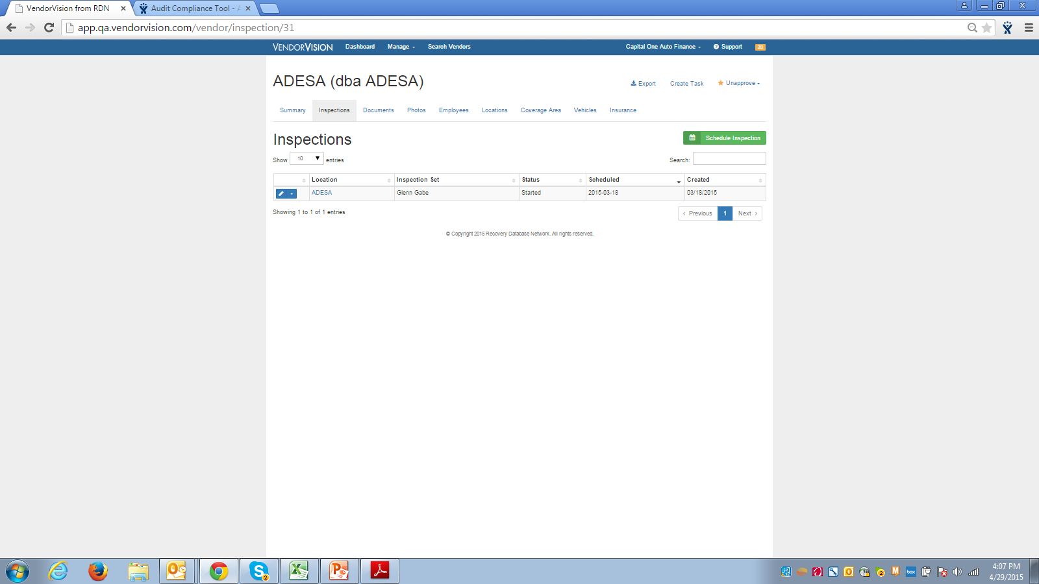
Lenders’ Module Release Features
On-site Inspection Enhancements
Inspection dates added
Schedule an inspection

Slide 8
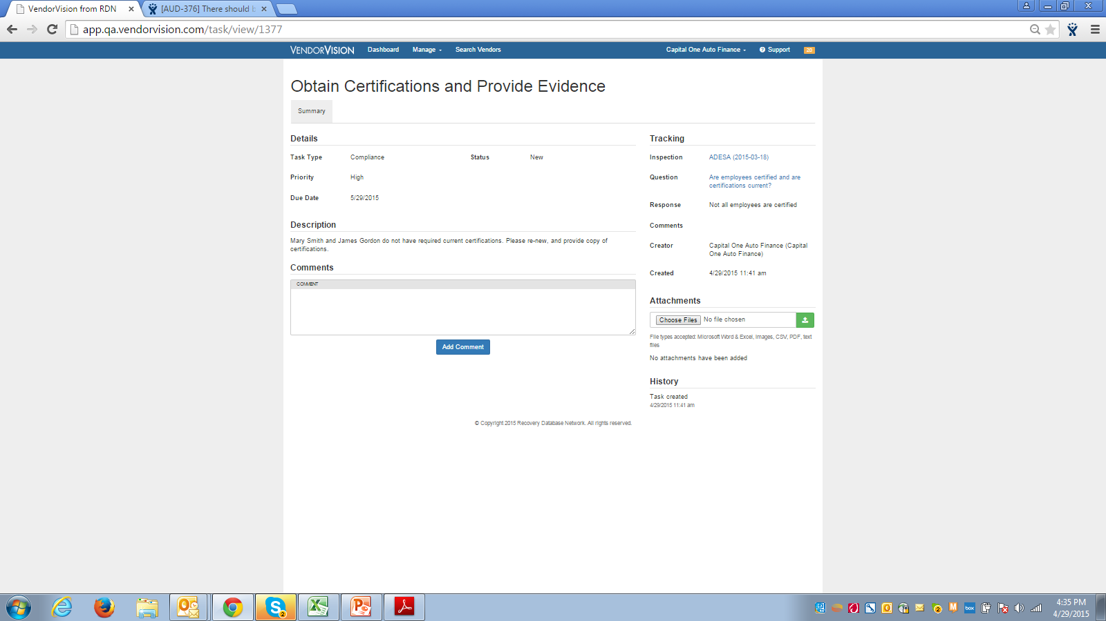
Lenders’ Module Release Features
Task Navigations Enhancements
Link to both the associated inspection and inspection question

Slide 9
Lenders’ Module Release Features
On-site Inspection Enhancement
Add photos

Slide 10
Support
Please contact Customer Support with any questions or additional information needed regarding these enhancements.
817-204-0298
support@recoverydatabase.net

