Slide 1
VendorVision Agent Module New Release Features
June 9, 2015
H. Balogh, G. Gabe
Confidential

Slide 2
VendorVision New Release Features
Agent changes on vetted items require the Lender to re-vet the item.
For example, if the Agent adds an insurance policy and the Lender accepts it, and then the Agent makes a change to the previously accepted ‘vetted’ policy, the item will go from a vetted to non-vetted status.

Slide 3
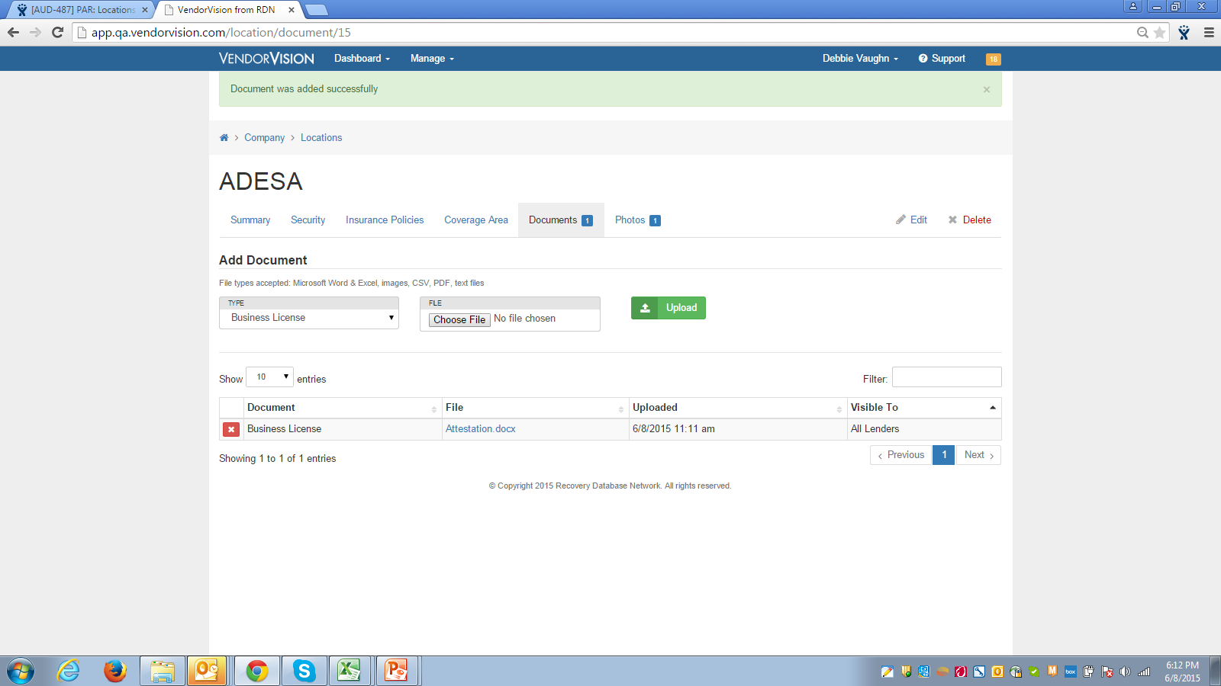
VendorVision New Release Features
Agents can load document(s) and control which Lender can view the loaded document(s).

Slide 4
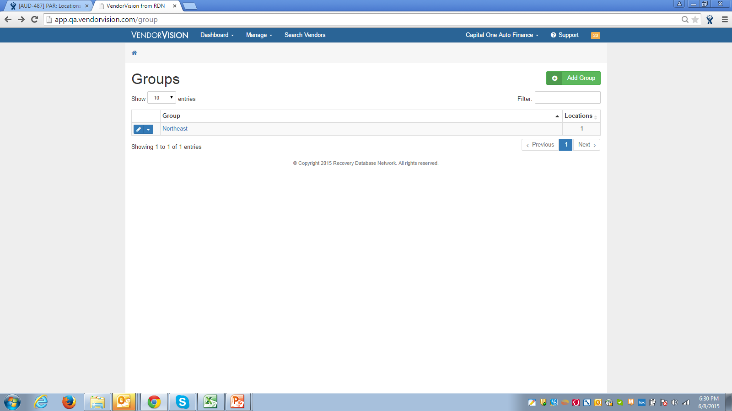
VendorVision New Release Features
Manage Groups by Location
Within Manage Groups, display is by Location with the option to add location groups.

Slide 5
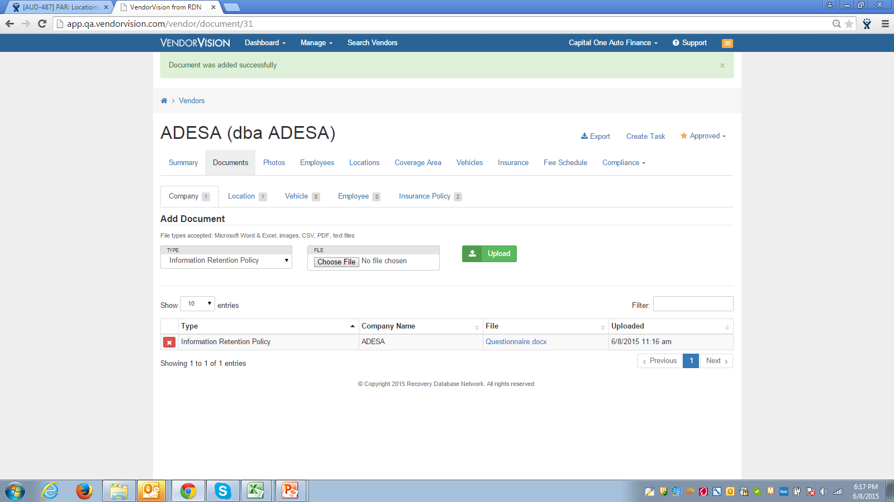
VendorVision New Release Features
Lender can add a document to an Agent’s profile, which will be visible to the Lender and Agent; however, only the Lender can edit the document.

Slide 6
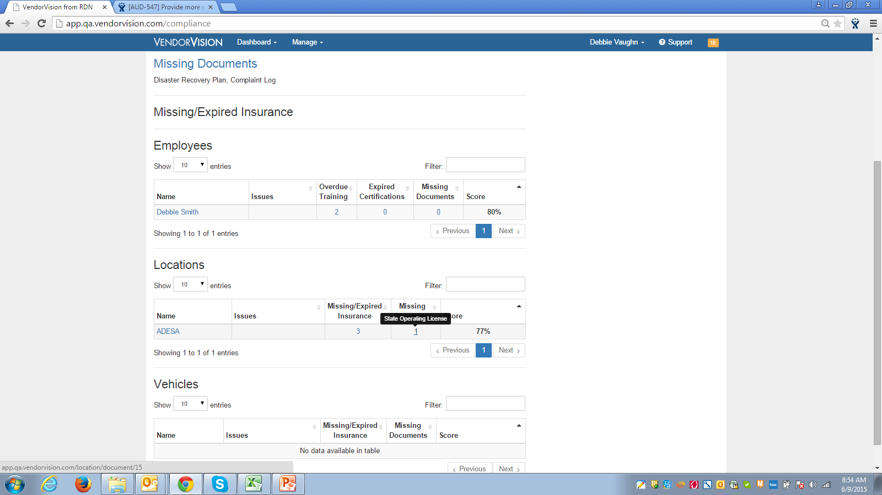
VendorVision New Release Features
Agents can now see what’s missing as it relates to their Compliance Dashboard.

Slide 7
Support
Please contact Customer Support with any questions or additional information needed regarding these enhancements.
817-204-0298
support@recoverydatabase.net

