Slide 1
VendorVision Lender and Agent Module New Release Features
June 9, 2015
H. Balogh, G. Gabe
Confidential

Slide 2
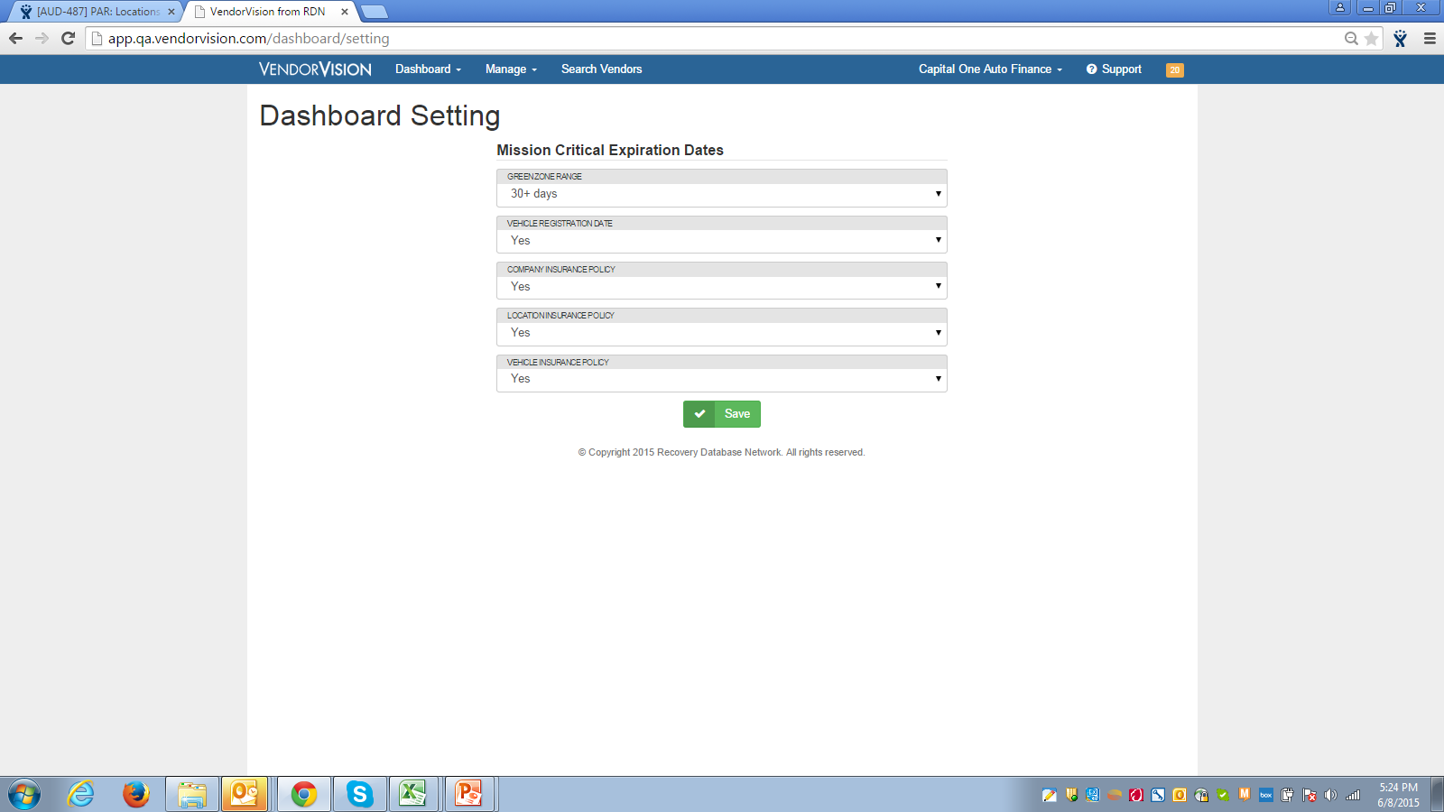
VendorVision New Release Features
Mission Critical Expiration Dates
The lender can set the Mission Critical Expiration Dates, thereby determining when an item is due (yellow), or not due (green)
The lender can now determine which items are considered ‘mission critical’ for the dashboard.

Slide 3
VendorVision New Release Features
Agent changes on vetted items require the Lender to re-vet the item.
For example, if the Agent adds an insurance policy and the Lender accepts it, and then the Agent makes a change to the previously accepted ‘vetted’ policy, the item will go from a vetted to non-vetted status.

Slide 4
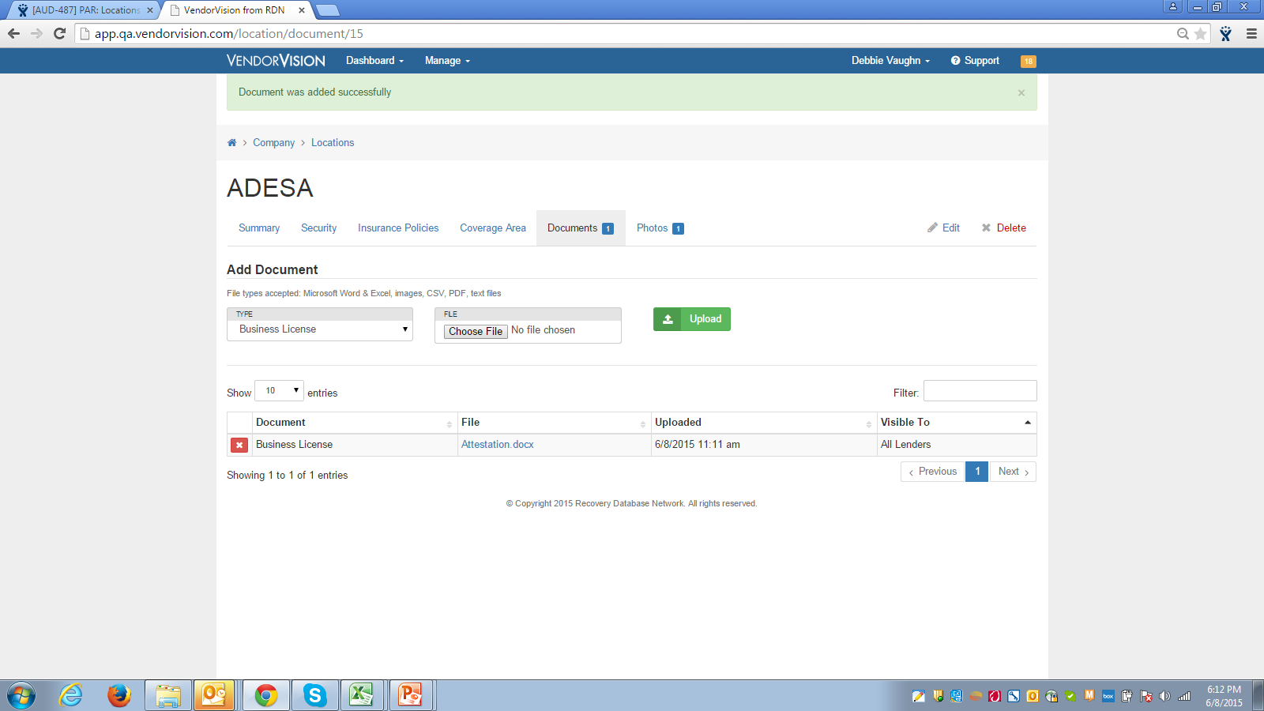
VendorVision New Release Features
Agents can load document(s) and control which Lender can view the loaded document(s).

Slide 5
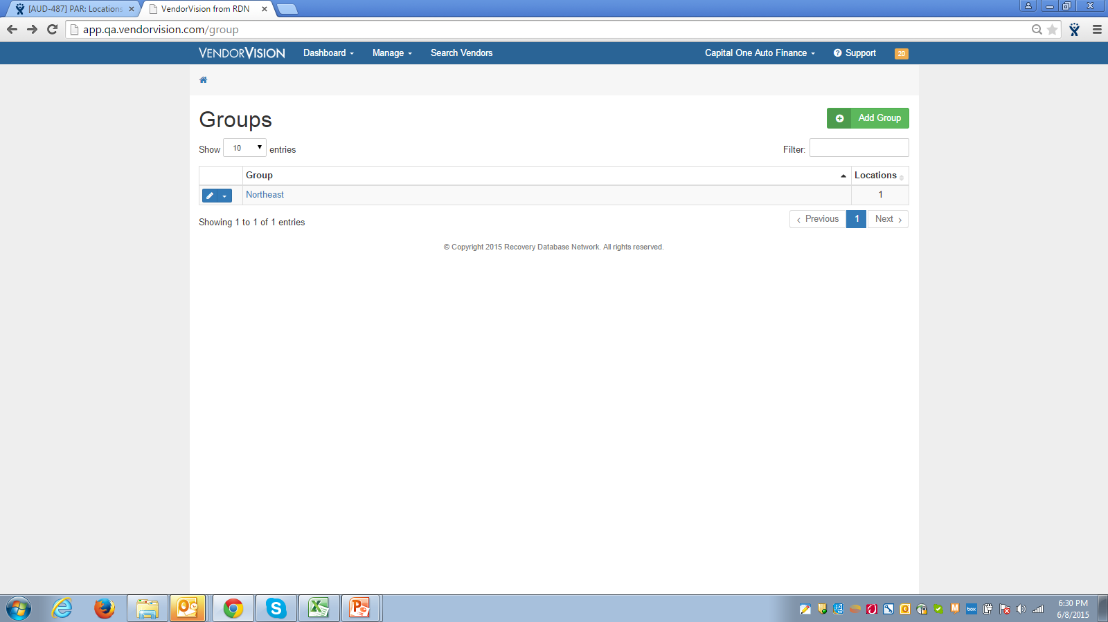
VendorVision New Release Features
Manage Groups by Location
Within Manage Groups, display is by Location with the option to add location groups.

Slide 6
VendorVision New Release Features
A Lender can create a user account with site inspection functionality only, allowing the Lender to contract with a Vendor to perform its site inspections. The Vendor will not be able to ‘Complete’ the site inspection, which allows for the Lender to review the site inspection and choose to ‘Complete’ the inspection if it’s acceptable to the Lender.

Slide 7
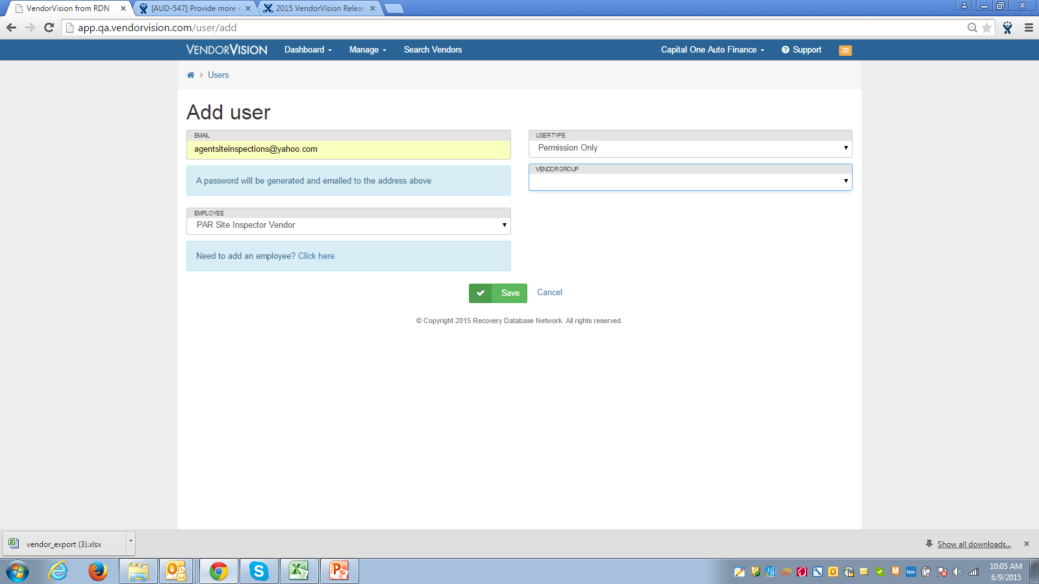
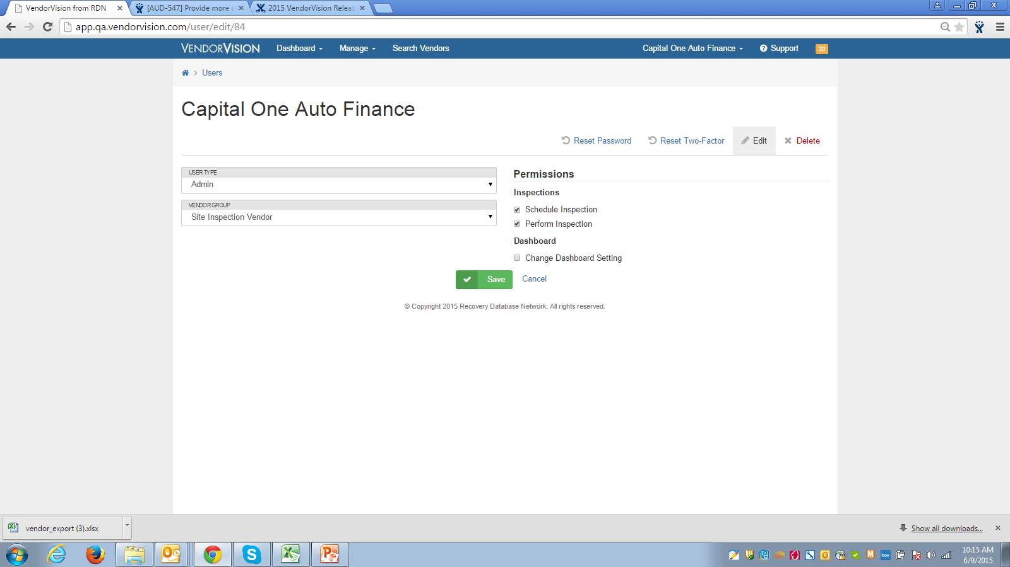
VendorVision New Release Features
Lender can create site inspection users

Slide 8
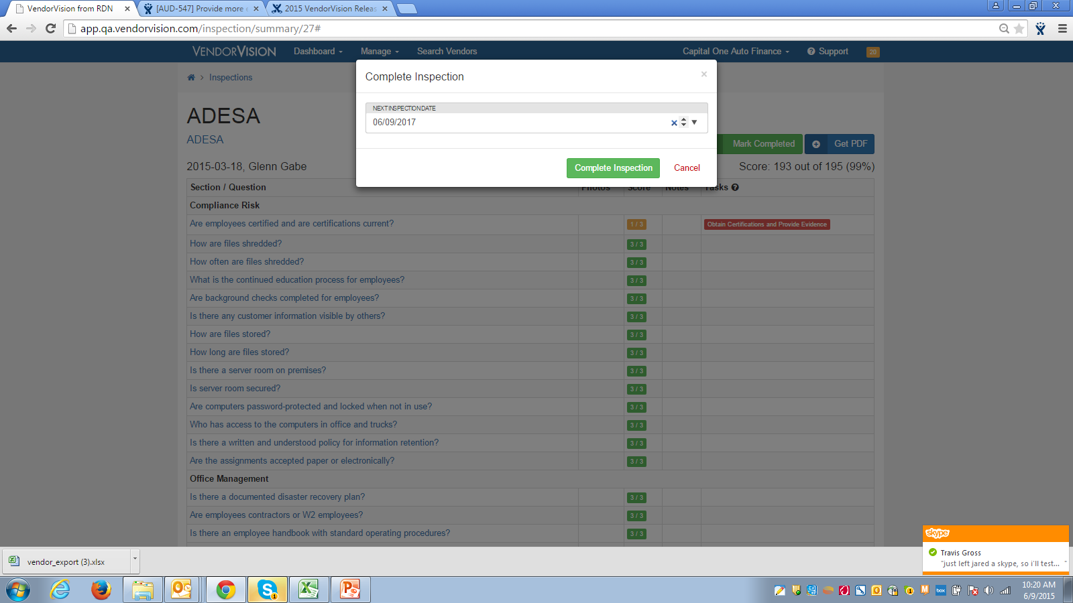
VendorVision New Release Features
To ensure that future site inspections are scheduled, once a site inspection is complete, a dialog box will prompt the user to schedule the next site inspection.
Once

Slide 9
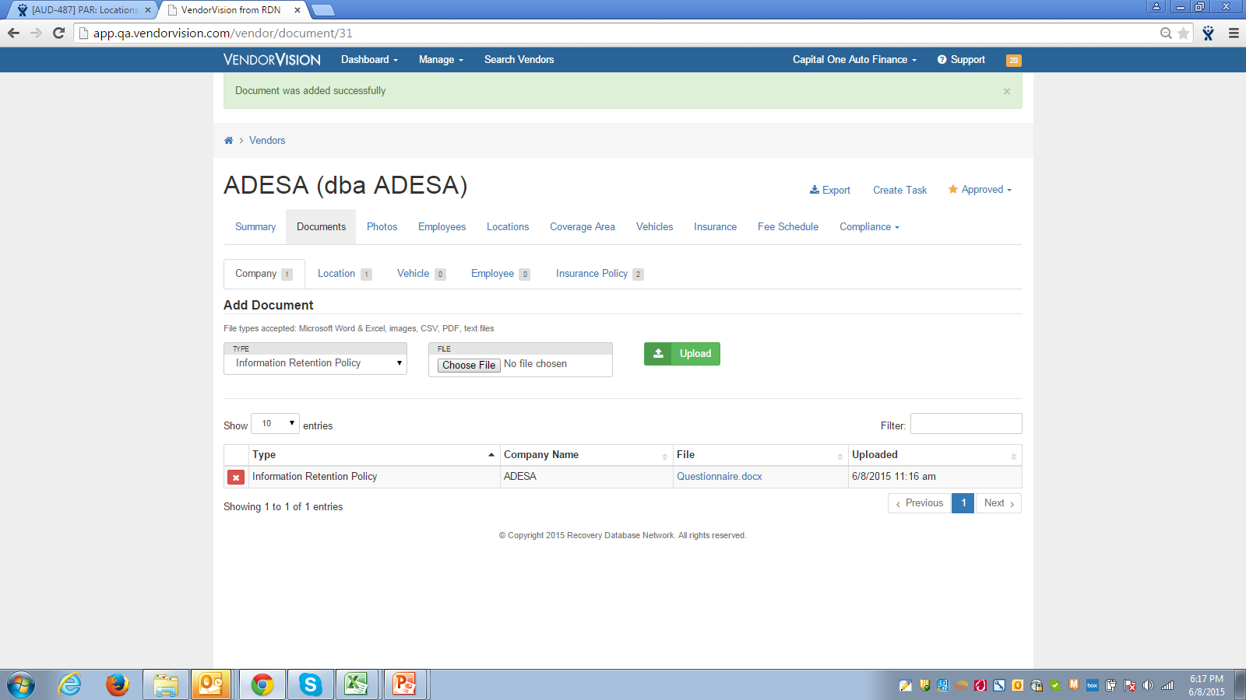
VendorVision New Release Features
Lender can add a document to an Agent’s profile, which will be visible to the Lender and Agent; however, only the Lender can edit the document.

Slide 10
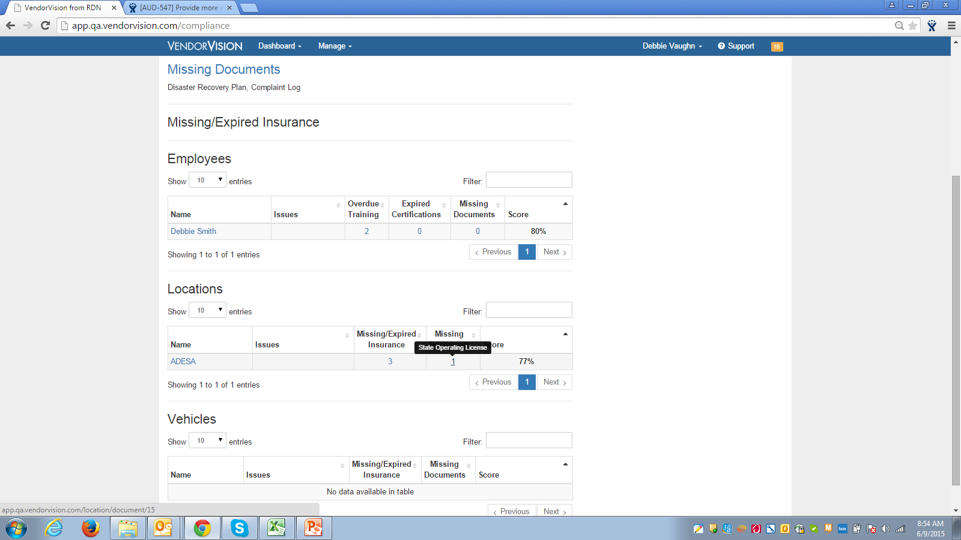
VendorVision New Release Features
Agents can now see what’s missing as it relates to their Compliance Dashboard.

Slide 11
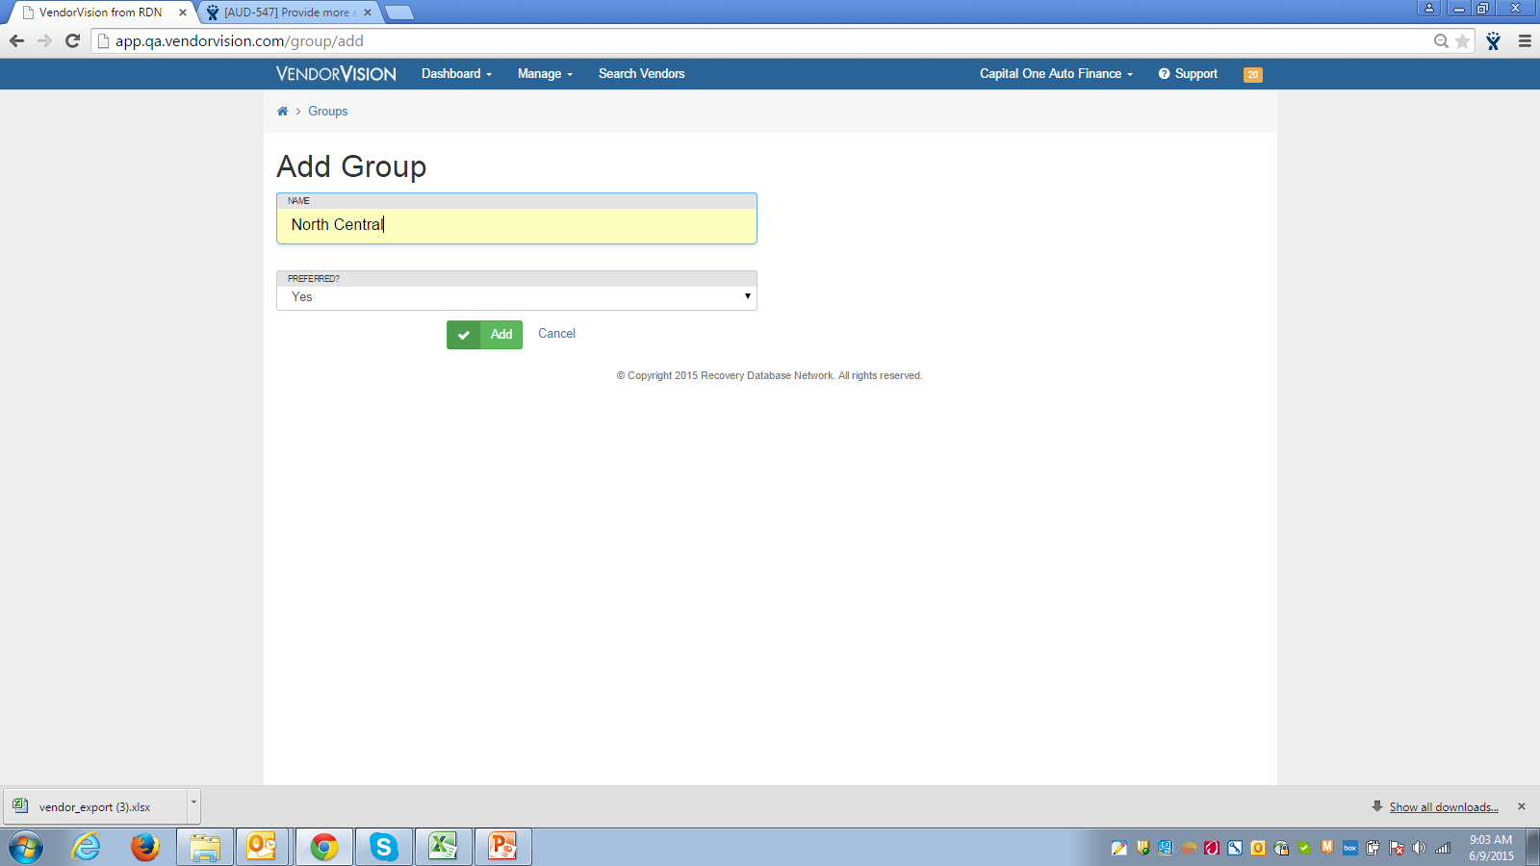
VendorVision New Release Features
Lender now has the ability to flag Agent’s location as a ‘Preferred’ provider.

Slide 12
Support
Please contact Customer Support with any questions or additional information needed regarding these enhancements.
817-204-0298
support@recoverydatabase.net

